Slide 1
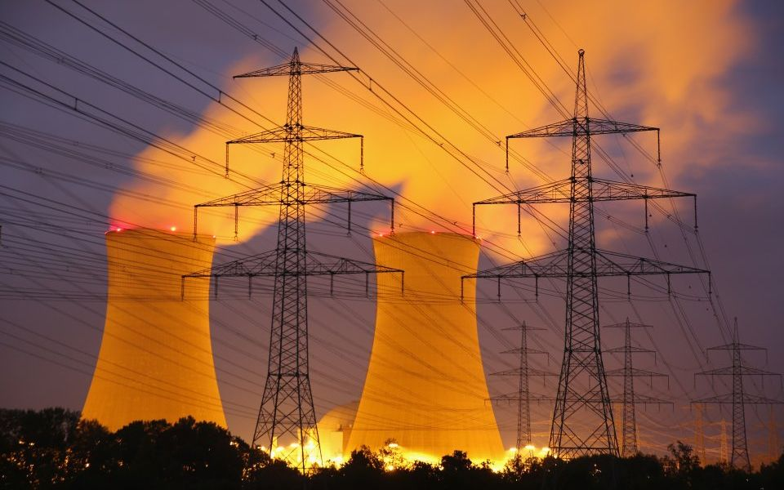
Addressing the decrease in grid stability allows us to focus on the ability to “load follow’, in order to match the energy output to the demand.
Current Methods of energy production include renewables, nuclear, and fossil fuels. Individually, these methods of energy production cannot provide the grid with clean, reliable, and affordable energy. In order to create a cleaner more reliable grid, our capstone team designed a model for a Nuclear Hybrid Energy System that is capable of providing sustainable generation methods to the grid. This model is an essential aspect in developing technology that is capable of meeting current and future energy demands.
A NR-HES is a multisystem comprised of a Nuclear Reactor, Renewable Energy Sources, and an industrial process that utilizes heat from the one of these energy sources
Generation IV Nuclear Reactor ( insert graphic)
2
Hydrogen Production Plant ( Insert graphic)
1
3
Renewable Energy Sources ( insert graphic)
4
Matlab and Simulink were used to characterize the system.
This code identified the expected energy and hydrogen output given changing energy demands.
An economic analysis was performed to determine the feasibility of the interconnection and to determine the optimal plant configuration. This optimization balanced plant efficiency and component cost.
Notes:
Solidify Content by: Tuesday
Solidify Template by: Wednesday
Individually, these methods of production have a difficult time adapting to changes in energy demands
Simulink was used to model the system graphically. With the use of the previously written matlab code, this system connected teh characterization of the system, in order to determine the system behavior.

